Slide 1


Potential Customer Profiling and Segmentation using LLM
Siva Ram Kottapalli
Nitish Satya Sai Gedela
Kevin Patel
Koushik Sai Veerella
Jian Yang
Michael Dessauer
( Westlake Chemical)

Slide 2
Objective
Implement Dynamic Web Scraping to gather data.
Leverage Large Language Models (LLMs) & Clustering techniques on Web Scraped data to predict potential customers for targeted marketing strategies using only available public data.

Slide 3
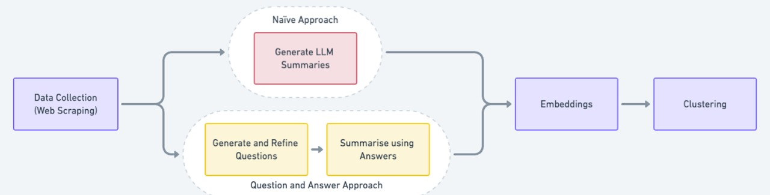
Project Workflow

Slide 4
Web Scraping Summary
Challenges
Beautiful Soup not effective for websites having dynamic web content.
Invalid/Duplicate websites: ~40
Some website responses are very slow.
Some websites require cookies acceptance.
Some websites have most text content in other tags (like br, div, meta, span) than ‘p’ tags.
Very limited hrefs or text content for some websites.
Some websites have text content in other languages - like nl/fr/de/ja/es.
Crawling for few companies was blocked.
Total companies Count: 722
Invalid/Duplicate Companies: 47
Companies Scraped: 675
Constraints used for Scraping:
Depth crawled per website: 5
Max URLs per company: 150
Approach:
Used Selenium.
Save to PDFs (1 per company)

Slide 5
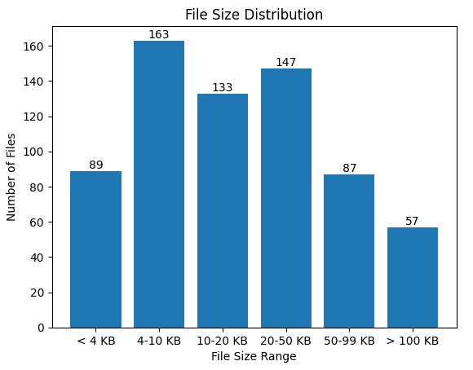
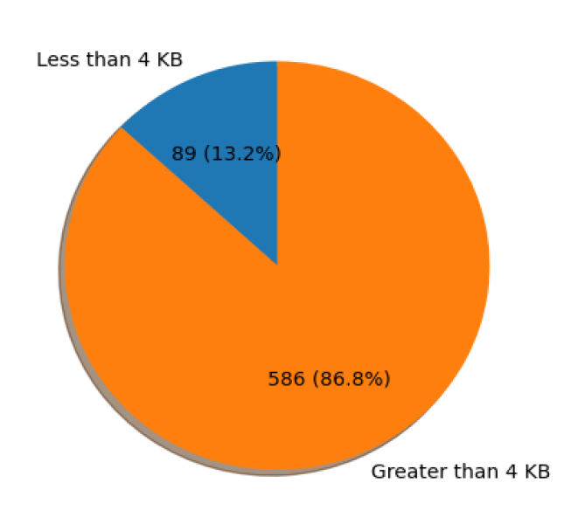
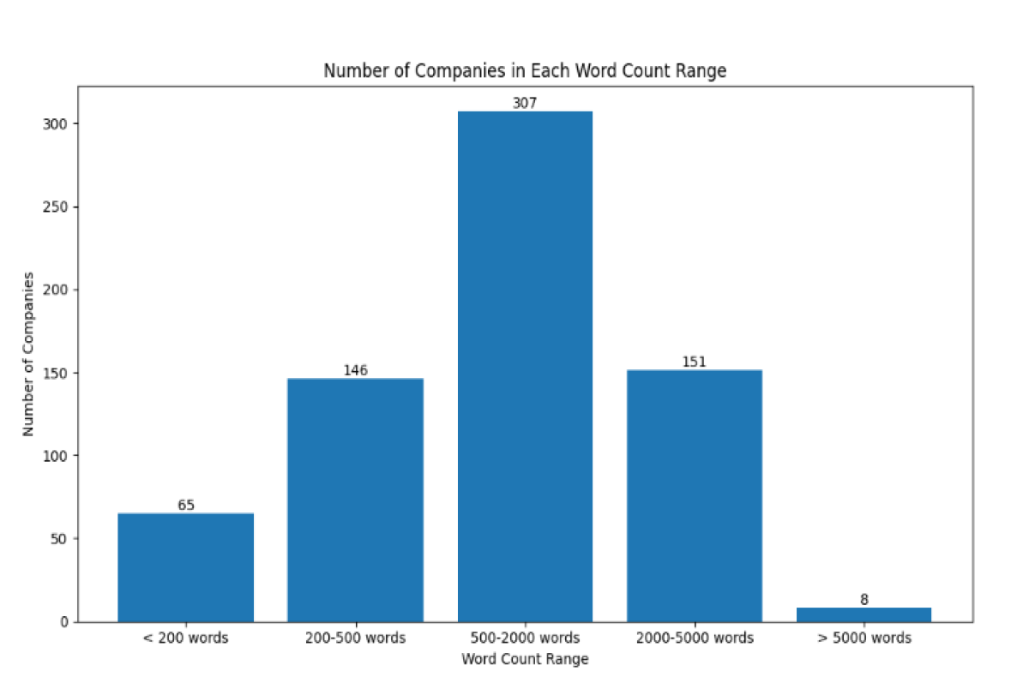
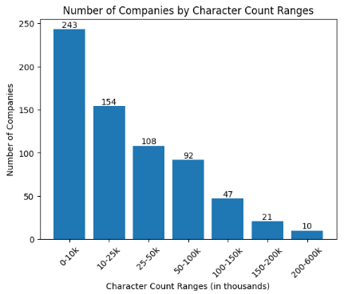
Data Collection Statistics
Total files: 675 (1 per company)
Companies with < 4 KB data: 89
Companies with > 4 KB data: 586
Mean File Size: 33.13 KB
Mean Word Count (per PDF): 1302
Mean Char Count (per PDF): 39628
Mean Char Count (per Page): 2741

Slide 6
Approach 1 : Naive Approach
Aim : Generate & Compare Naive Summaries for all companies.
Input: PDFs from Web Scraped data
Output: Summarized Company data of ~500 words
Approach:
In-depth study and experimentation of Text Splitters and chain_types (Stuffing, Map-Reduce, Refine, Map-Rerank) for PDF Text Summarisation.
Leverage LangChain's 'load_summarize_chain' with the 'map_reduce' option and employ prompt engineering to derive summaries from input PDF

Slide 7
LLM Langchain Summarization Approaches
Text Splitters
CharacterTextSplitter
RecursiveCharacterTextSplitter
TokenTextSplitter
load_summarize_chain():
Stuff
Refine
Map-Reduce

Slide 8
Embeddings
Clustering
Input: Summarized/Structured Company data
Output: Vector Embeddings of Textual data.
Approach:
Use OpenAIEmbeddings (text-embedding-ada-002) to convert character chunks into embeddings.
Use FAISS/Chroma DB to store the embedded chunks.
Input: Vector Embeddings of Text Data.
Output: Clusters of companies.
Approach:
Unsupervised clustering of Vector Embeddings of Textual Data.
Utilize clustering techniques - K-Means, DBScan - to generate clusters of semantically similar companies.
Use Metrics (Silhoutte, distortion Scores) to evaluate performance of Clustering.

Slide 9
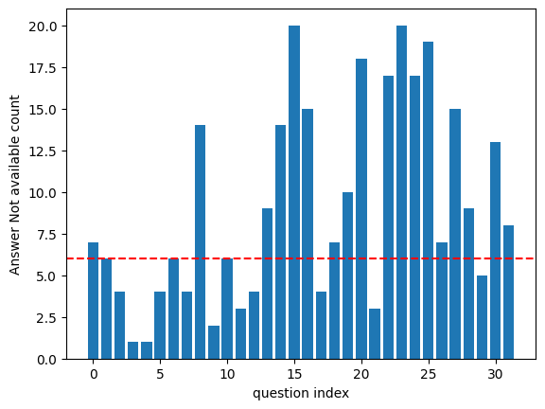
Approach 2 : Q&A approach
Why ?? To maintain contextual similarity for comparing companies (by Q&A)
Process :
Input: PDFs from Web Scraped data
Output: Structured Representation of Company Data (14xN (14 Questions. N dimensions for embedding model)).
Approach:
Generate Questions from PDFs using LangChain’s load_summarize_chain (question_prompt).
Refine Questions using Clustering & Statistics.
Use RAG (Retrieval Augmented Generation) approach to generate Answers for Select Questions.
Generate Answers & Embeddings for Select Questions.

Slide 10
Approach 2: Questions we have decided to Proceed
How does the company ensure quality control in their manufacturing process?',
What types of products does the company specialize in manufacturing?
How does the company's expertise set them apart in the industry, and what capabilities do they offer?
In which industries does the company provide their products and services?
What types of products does the company offer?
How does the company cater to the unique demands of different industries?
How does the company ensure quality and customer satisfaction in their products and services?
What is the purpose of the company?
Where is the company located and how long have they been in business?
How does the company ensure precision and quality in its processes?
What materials does the company use in its products?
How can customers contact the company to inquire about their solutions or services?
How does the company ensure that its manufacturing processes are efficient and cost-effective for customers?
How does the company offer precision, quality, and speed in its products and services?

Slide 11
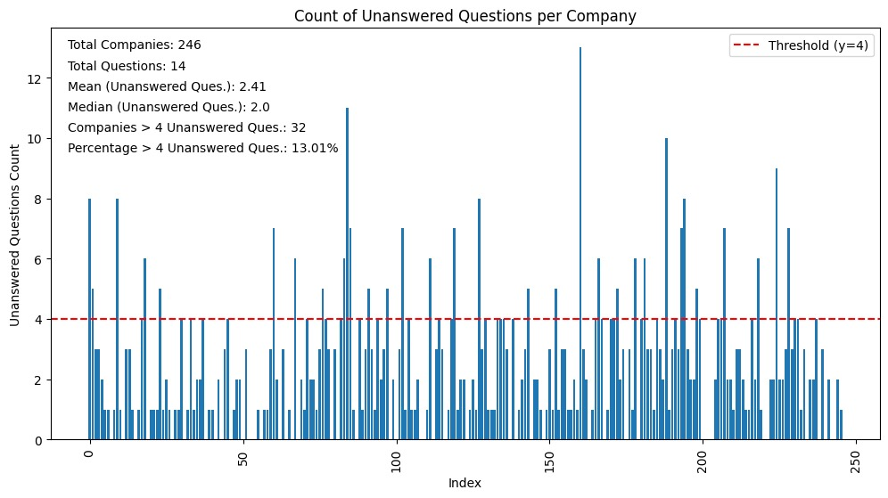
Q&A approach analysis

Slide 12
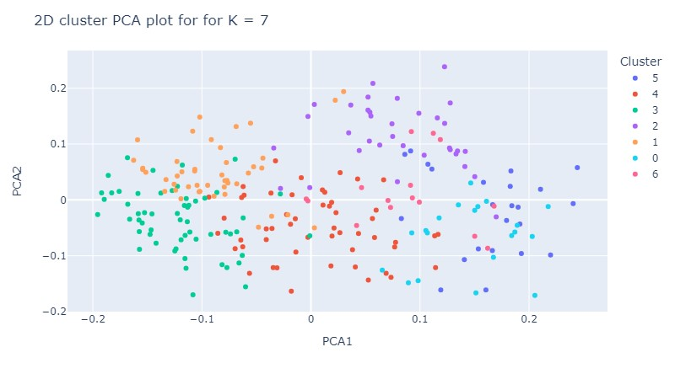
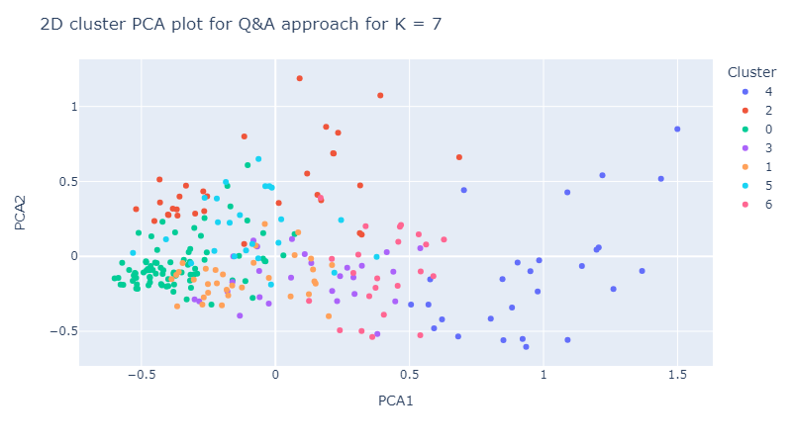
Approach 2: Proceed with answer
Combining all the answer into single summary and generate embeddings for the same.
Data shape : N X 1536
N : no of company and 1536 : embedding shape for Ada-002 model
Treated Each answer individually by concatenating there individual embeddings and than cluster them.
Data shape : N X (1536 * 14) = N X 21504
N : no of company and 1536 : embedding shape for Ada-002 model

Slide 13
Silhouette Scores Comparison
Method | DBScan clustering | K-means with k=2 | K-means with k = 7
Naive Approach | 0.0084 | 0.0484 | 0.00824
Q&A approach
Summarised Answer Set | 0.00637 | 0.0598 | 0.0115
Separate Answer based clustering | 0.0115 | 0.0741 | 0.0258

Slide 14
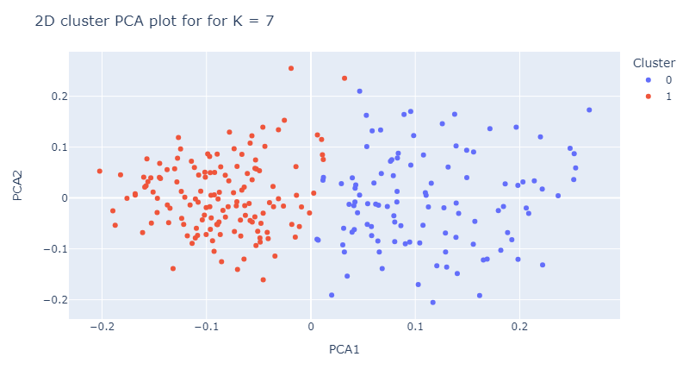
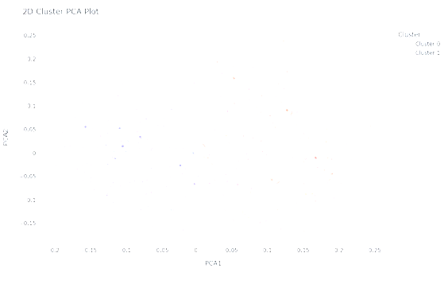
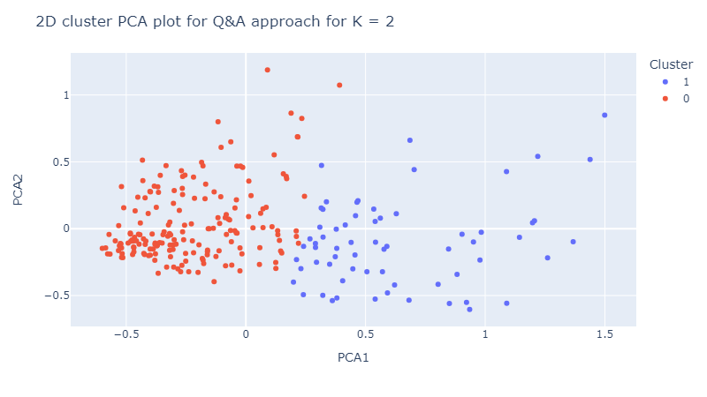
Approach comparison (Naive, Q&A)
Naive Approach
Q&A Approach

Slide 15
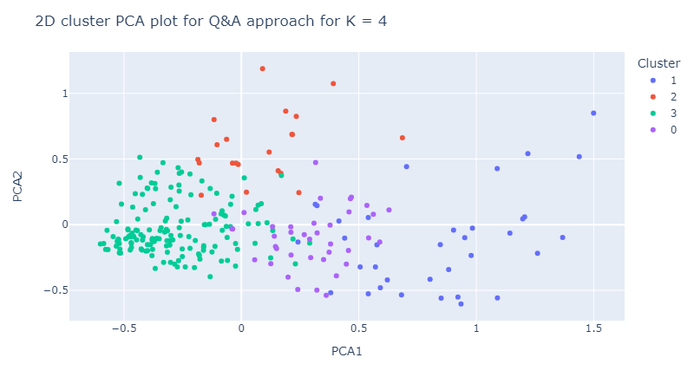
Q&A Plots with K=2, 4, 7 clusters

Slide 16
Future Directions and Conclusion
Conclusion:
Leveraging LLMs can definitely help gain valuable insights from data.
Q&A approach has improved the overall clustering performance and is a more structured approach than Naive Summaries Approach.
Way Forward:
Use more open and available sources to generate & leverage information of potential customer profiles.
Use supervised clustering (with existing clients data) techniques to boost the objective of predicting potential customers using LLMs.
Knowledge Graph Generation for improving Answer quality for Text Data.

Slide 17
Thank You

